Slide 1
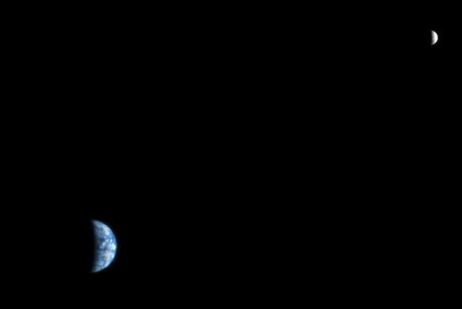
Lunar atmospheric composition experiment (LACE)
Katie Pazamickas

Slide 2
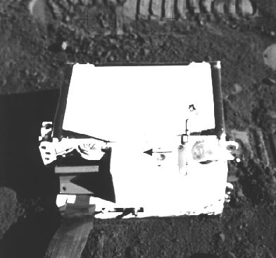
LACE
Flew on Apollo 17 as a part of ALSEP.
Deployed in the Taurus-Littrow Valley (30° 45’ 53.6” E and 20° 11’ 31.6” N)
Turned on Dec. 27, 1972 at 18:07
Notes:
ALSEP experiments were Apollo Lunar Surface Experiments Package. The Apollo Lunar Surface Experiments Package (ALSEP) comprised a set of scientific instruments placed by the astronauts at the landing site of each of the five Apollo missions to land on the Moon following Apollo 11 (Apollos 12, 14, 15, 16, 17).
Turned on approx. 50 hours after sunset which occurred on Christmas 1972 at 10:51

Slide 3
The moon has an atmosphere?
Gas molecules travel in ballistic trajectories between collisions with the lunar surface → classic exosphere.
Sources come from solar wind, lunar volcanism or meteoroid impacts.
No dipolar magnetic field, however once every lunar orbit the moon will pass through the Earth’s magnetotail for approximately 6 days.
Notes:
Mainly from solar wind—light gases (H and He) will escape thermally while heavier gases will go through photoionization followed by accelerations of the solar wind electric field.
The moon does not have a dipolar magnetic field, however once every lunar orbit the moon will pass through the earth’s magnetotail for approx. 6 days. During this time electrons on the nightside will accumulate and surface voltages are raised creating a dust atmosphere on the nightside. On the dayside, the sunlight will knock the electrons back off the surface.

Slide 4
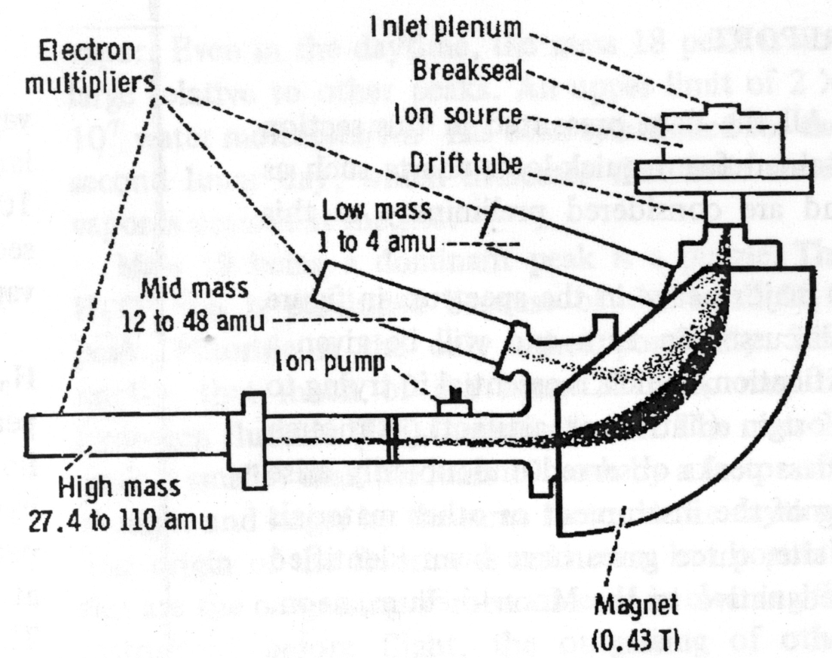
How LACE Works
Gas molecules enter and are ionized by an electron bombardment ion source, collimated into a beam and sent through a magnetic analyzer to a detection system.
3 mass ranges scanned simultaneously.
Notes:
The second and third mass ranges overlap so that mass 28 and 64 peaks are detected simultaneously (CO and SO₂ are possible candidates for volcanic gases).

Slide 5
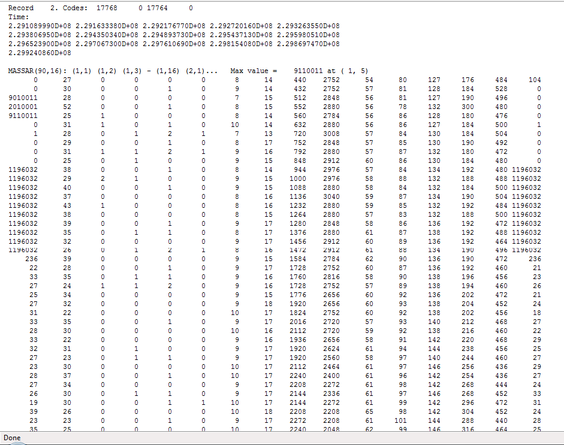
Notes:
Raw data, as read by Kent Hills from microfilm. The time is in milliseconds, there are two sets of housekeeping data, and 90 extra other numbers.

Slide 6
LACE Data
Each record consists of 90 x 16 array of numbers, or 1440 numbers, with only 1330 numbers of actual data.
1330 steps, with a time between steps of .6 sec
10 steps of background and 10 steps of internal calibration are inserted between sweeps
A sweep is 13.5 min
Time is in milliseconds starting from ?
Notes:
This left 110 extra numbers. After dissecting the Apollo 17 PSR it was determined that the 10 numbers before the calibration number were inserted before both calibrations. After more careful observation it was discovered that the last 70 numbers in the record were simply the first numbers in the next record.

Slide 8
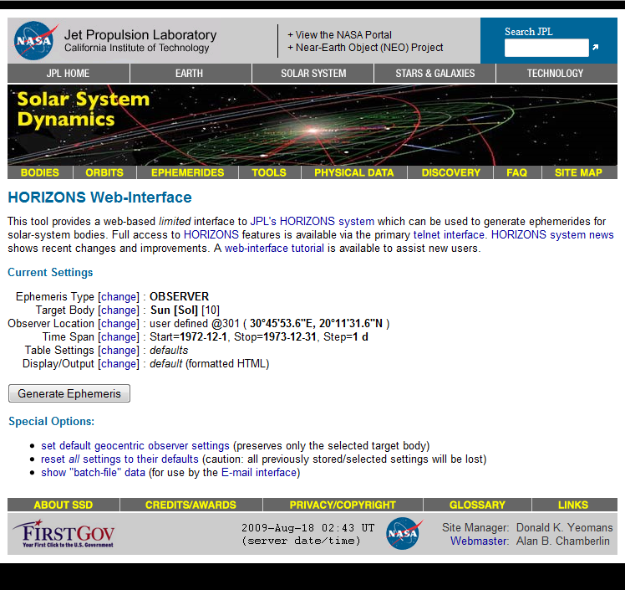
Notes:
This interface allowed us to get the times for sunrise/sunset on the lunar surface. The parameters were simply placed into the New Horizons Web interface and the latitude/longitude was defined for where Apollo 17 and LACE was located, and then the times were set up on the screen.

Slide 9
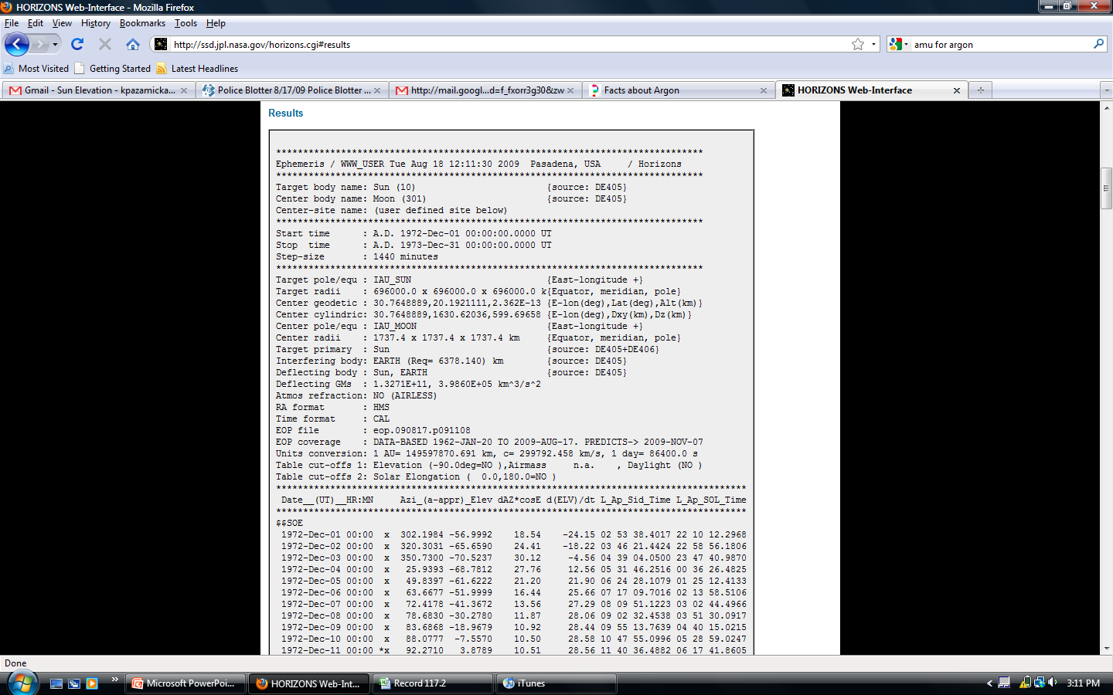
Notes:
The results of the New Horizons interface, the elevation was the column of interest, with the date and time.

Slide 10
Amu Calculations

Slide 11
Daily Graphs Analysis
Time chart created in Excel
file:///H:/Documents/Katie%20Presentation%202010/Daily%20Graphs/MASSAR/dailygraphsmassar.html
file:///H:/Documents/Katie%20Presentation%202010/Daily%20Graphs/MASSBR/dailygraphsmassbr.html
file:///H:/Documents/Katie%20Presentation%202010/Daily%20Graphs/MASSCR/dailygraphsmasscr.html

Slide 12
Moonquakes/Meteoroid Impacts
Moonquakes—leak gasses into the atmosphere, only one moonquake (Feb 1, 1973) took place while LACE was on/geographically near LACE and no major differences were noted.
Meteoroid Impacts—stir up dust and particles in the lunar atmosphere. Events were analyzed during common meteor showers, with no major differences noted.

Slide 13
Transient Lunar Phenomena
Short lived changes in the brightness of patches on the surface of the moon
Observed on Jun 6, 1973 near LACE
file:///H:/Documents/NASA/Jun%206/MASSAR/june6massar.html
file:///H:/Documents/NASA/Jun%206/MASSBR/june6massbr.html
file:///H:/Documents/NASA/Jun%206/MASSCR/june6masscr.html

Slide 20
Paper Graph
Analyzed graph in Apollo 17 PSI
Slight differences in mass numbers were noticed

Slide 22
Thank You!
Dr. Dave Williams
Dr. Kent Hills
Dr. Ed Grayzeck
Cori Quirk

